Slide 1

ICE 3161
COMMUNICATION ENGINEERING
Dr. Asif Zaman
Professor, CSE, RU

Slide 2
Cyclic Codes
Cyclic codes are special linear block codes with one extra property.
In a cyclic code, if a codeword is cyclically shifted (rotated), the result is another codeword.
For example,if 1011000 is a codeword and we cyclically left-shift, then 0110001 is also a codeword

Slide 3
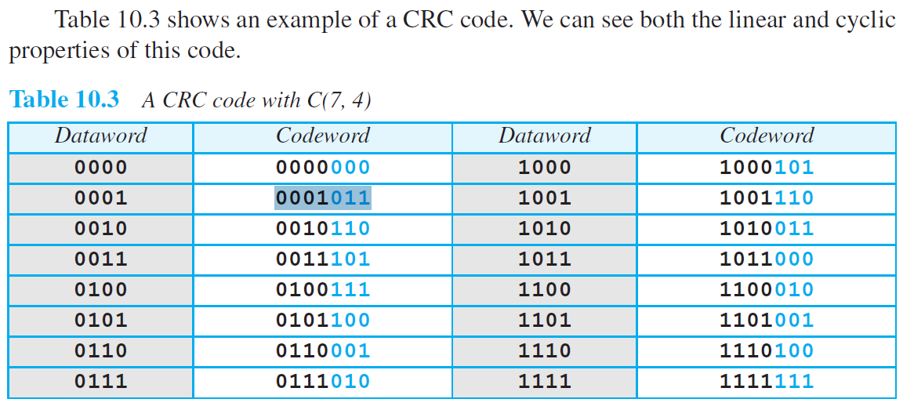
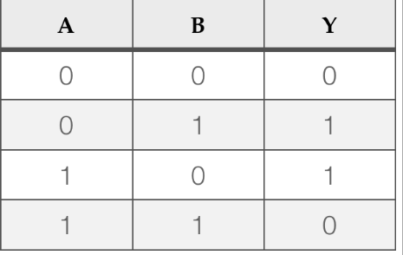
Cyclic Redundancy Check (CRC)
0001011
0010110
0011101

Slide 4
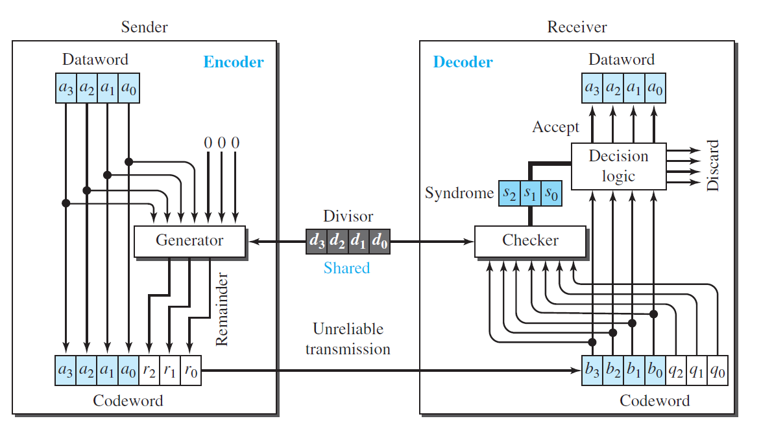

Slide 5
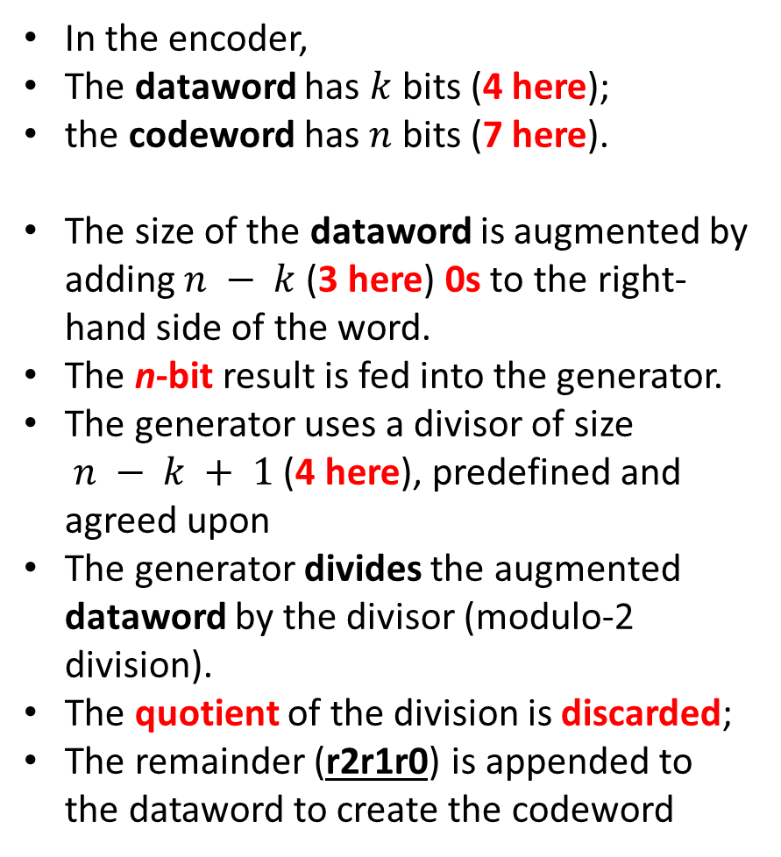
In the encoder,
The dataword has $k$ bits (4 here);
the codeword has $n$ bits (7 here).
The size of the dataword is augmented by adding $n − k$(3 here) 0s to the right-hand side of the word.
The n-bit result is fed into the generator.
The generator uses a divisor of size $n − k + 1$(4 here), predefined and agreed upon
The generator divides the augmented dataword by the divisor (modulo-2 division).
The quotient of the division is discarded;
The remainder (r2r1r0) is appended to the dataword to create the codeword

Slide 6
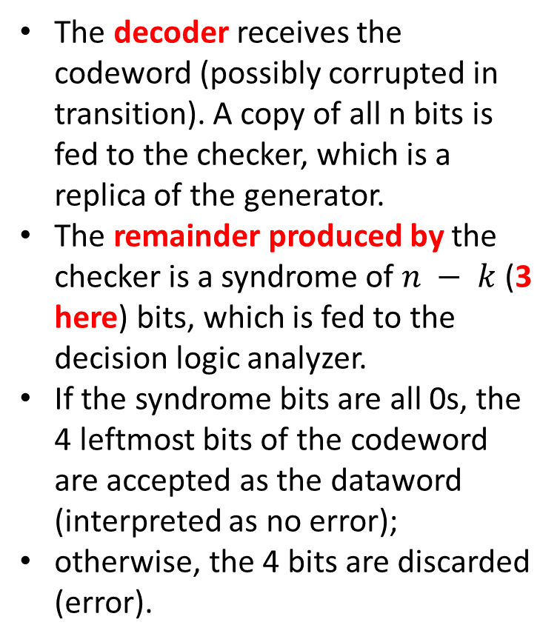
The decoder receives the codeword (possibly corrupted in transition). A copy of all n bits is fed to the checker, which is a replica of the generator.
The remainder produced by the checker is a syndrome of $n − k$(3 here) bits, which is fed to the decision logic analyzer.
If the syndrome bits are all 0s, the 4 leftmost bits of the codeword are accepted as the dataword (interpreted as no error);
otherwise, the 4 bits are discarded (error).

Slide 7
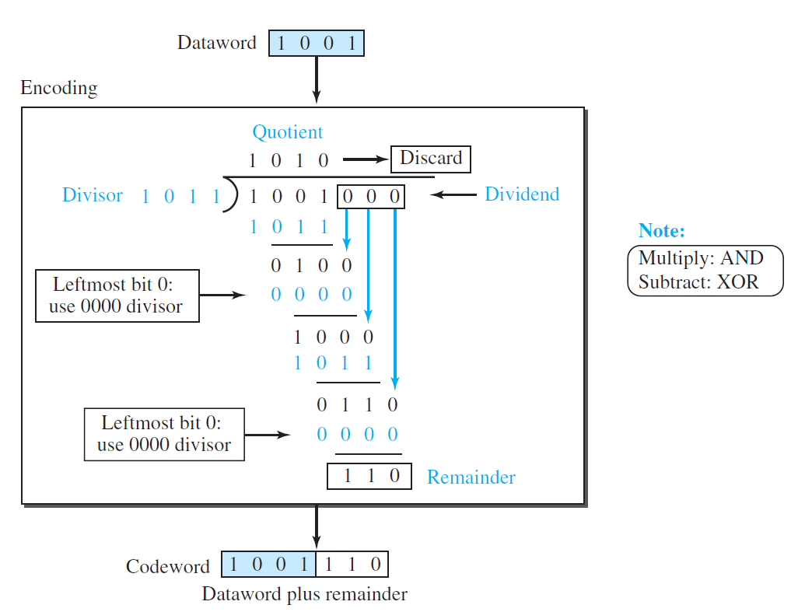

Slide 8
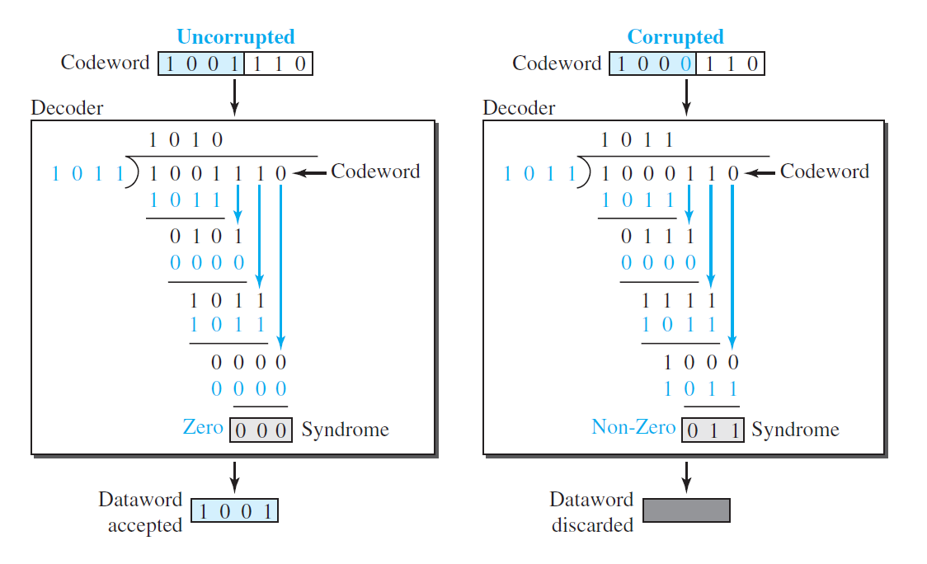

Slide 9
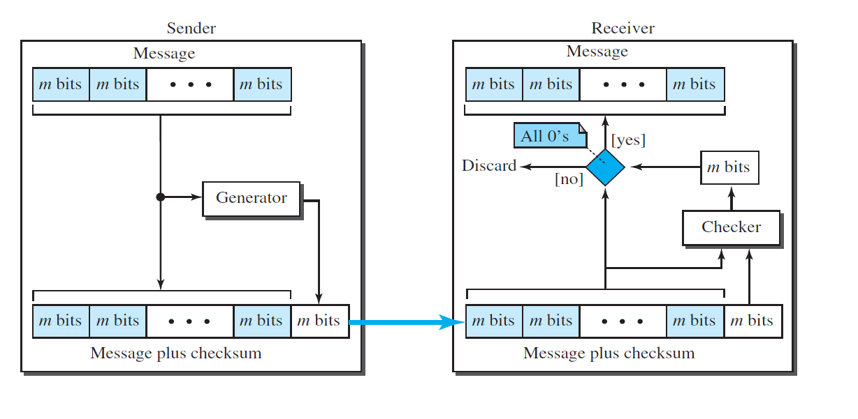
Checksum
Checksum is an error-detecting technique that can be applied to a message of any length.

Slide 10
Example
Suppose the message is a list of five 4-bit numbers that we want to send to a destination.
In addition to sending these numbers, we send the sum of the numbers.
For example, if the set of numbers is (7, 11, 12, 0, 6), we send (7, 11, 12, 0, 6, 36), where 36 is the sum of the original numbers.
The receiver adds the five numbers and compares the result with the sum.
If the two are the same, the receiver assumes no error, accepts the five numbers, and discards the sum.
Otherwise, there is an error somewhere and the message is not accepted.

Slide 11

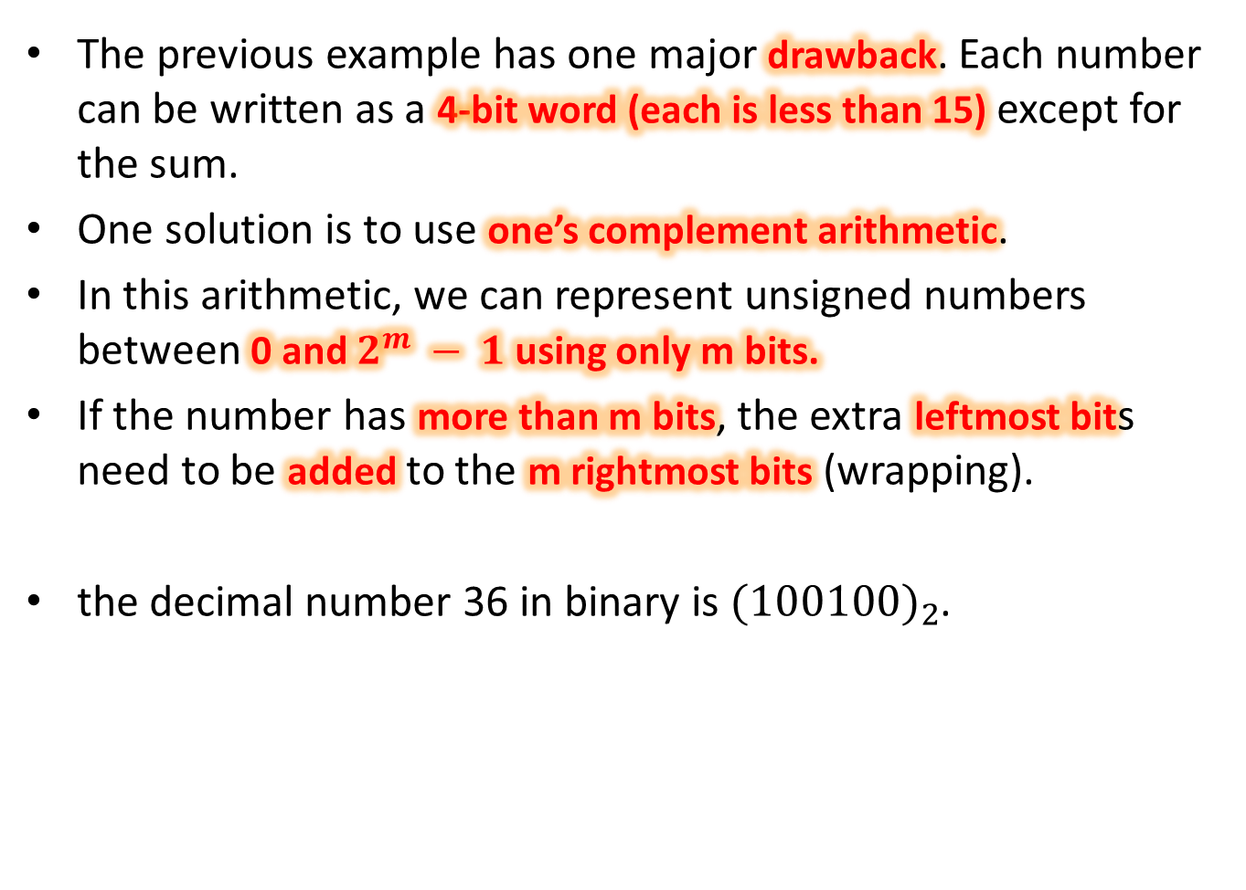
The previous example has one major drawback. Each number can be written as a 4-bit word (each is less than 15) except for the sum.
One solution is to use one’s complement arithmetic.
In this arithmetic, we can represent unsigned numbers between 0 and $2^{m} − 1$using only m bits.
If the number has more than m bits, the extra leftmost bits need to be added to the m rightmost bits (wrapping).
the decimal number 36 in binary is${(100100)}_{2}$.

Slide 12
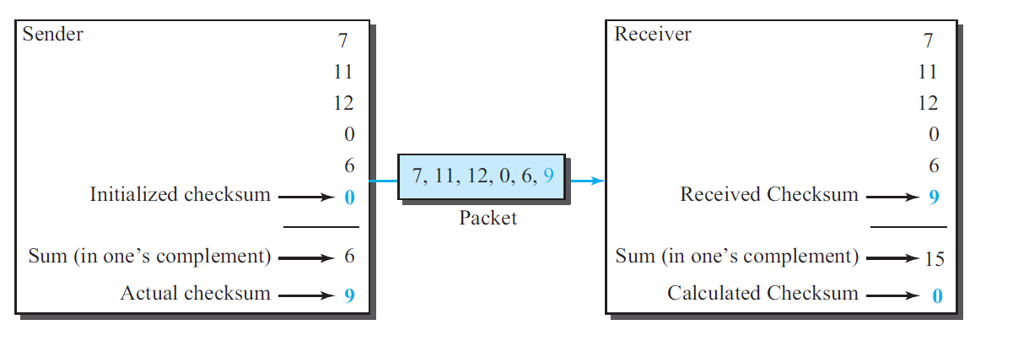

We can make the job of the receiver easier if we send the complement of the sum, the checksum.
In one’s complement arithmetic, the complement of a number is found by completing all bits (changing all 1s to 0s and all 0s to 1s).
This is the same as subtracting the number from $2^{m} − 1$
45 in binary is 101101

Slide 13
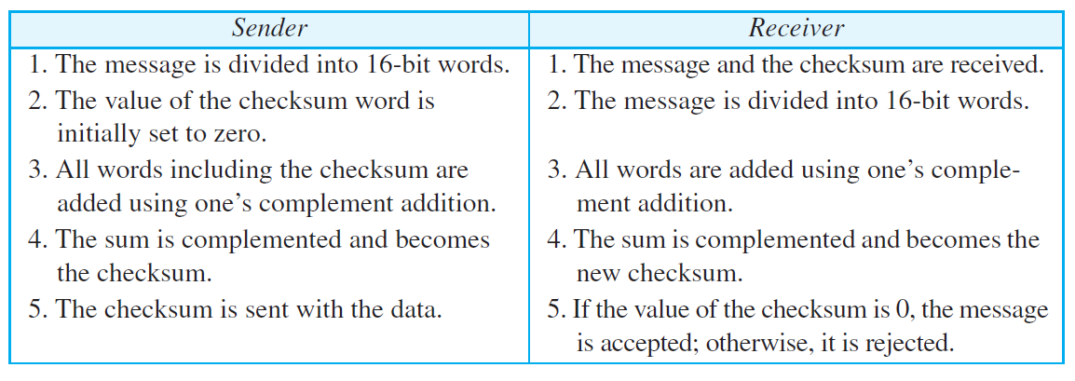
Internet Checksum

Slide 14
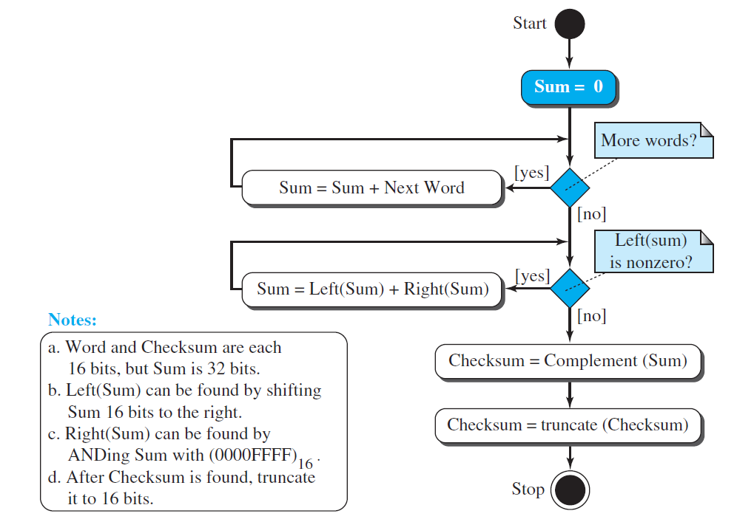

Slide 15
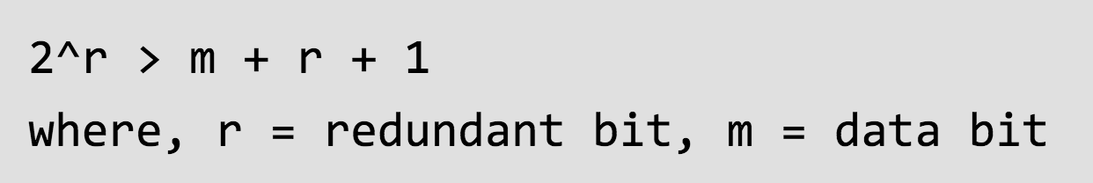
Forward Error Correction
Hamming Code
A frame consists of $m$ data (i.e., message) bits and
$r$redundant (i.e. check) bits.
Suppose the number of data bits is 7, then the number of redundant bits can be calculated using: =$2^4>7 + 4 + 1$ Thus, the number of redundant bits= 4

Slide 16
Hamming Code
Parity bits –
A parity bit is a bit appended to a data of binary bits to ensure that the total number of 1’s in the data are even or odd. Parity bits are used for error detection.
There are two types of parity bits:
Odd parity
Even Parity

Slide 17
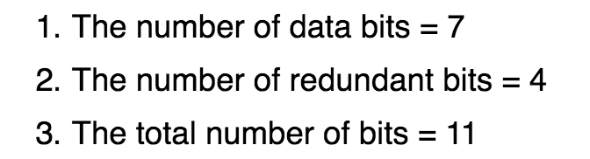
Hamming Code
1011001
11 | 10 | 9 | 8 | 7 | 6 | 5 | 4 | 3 | 2 | 1
$2^{0}=1$
$2^{1}=2$
$2^{2}=4$
$2^{3}=8$
11 | 10 | 9 | 8 | 7 | 6 | 5 | 4 | 3 | 2 | 1
D11 | D10 | D9 | R8 | D7 | D6 | D5 | R4 | D3 | R2 | R1
1 | 0 | 1 | R8 | 1 | 0 | 0 | R4 | 1 | R2 | R1

Slide 18
11 | 10 | 9 | 8 | 7 | 6 | 5 | 4 | 3 | 2 | 1
11 | 10 | 9 | 8 | 7 | 6 | 5 | 4 | 3 | 2 | 1
1 | 0 | 1 | R8 | 1 | 0 | 0 | R4 | 1 | R2 | R1
$$01=0001$$
$$02=0010$$
$$03=0011$$
$$04=0100$$
$$05=0101$$
$$06=0110$$
$$07=0111$$
$$08=1000$$
$$09=1001$$
$$10=1010$$
$$11=1011$$

Slide 19
Hamming Code
1 | 0 | 1 | R8 | 1 | 0 | 0 | R4 | 1 | R2 | R1
$$01=0001$$
$$02=0010$$
$$03=0011$$
$$04=0100$$
$$05=0101$$
$$06=0110$$
$$07=0111$$
$$08=1000$$
$$09=1001$$
$$10=1010$$
$$11=1011$$
$$01=0001$$
$$02=0010$$
$$03=0011$$
$$04=0100$$
$$05=0101$$
$$06=0110$$
$$07=0111$$
$$08=1000$$
$$09=1001$$
$$10=1010$$
$$11=1011$$
$$01=0001$$
$$02=0010$$
$$03=0011$$
$$04=0100$$
$$05=0101$$
$$06=0110$$
$$07=0111$$
$$08=1000$$
$$09=1001$$
$$10=1010$$
$$11=1011$$
$$01=0001$$
$$02=0010$$
$$03=0011$$
$$04=0100$$
$$05=0101$$
$$06=0110$$
$$07=0111$$
$$08=1000$$
$$09=1001$$
$$10=1010$$
$$11=1011$$
$$01=0001$$
$$02=0010$$
$$03=0011$$
$$04=0100$$
$$05=0101$$
$$06=0110$$
$$07=0111$$
$$08=1000$$
$$09=1001$$
$$10=1010$$
$$11=1011$$

Slide 20
Even Parity: $R1=0$
11 | 10 | 9 | 8 | 7 | 6 | 5 | 4 | 3 | 2 | 1
1 | 0 | 1 | R8 | 1 | 0 | 0 | R4 | 1 | R2 | R1
1 | 0 | 1 | R8 | 1 | 0 | 0 | R4 | 1 | R2 | 0
1 | 0 | 1 | R8 | 1 | 0 | 0 | R4 | 1 | R2 | 0
1 | 0 | 1 | R8 | 1 | 0 | 0 | R4 | 1 | 1 | 0
$$R2=1$$
1 | 0 | 1 | R8 | 1 | 0 | 0 | R4 | 1 | 1 | 0
1 | 0 | 1 | R8 | 1 | 0 | 0 | 1 | 1 | 1 | 0
1 | 0 | 1 | R8 | 1 | 0 | 0 | 1 | 1 | 1 | 0
1 | 0 | 1 | 0 | 1 | 0 | 0 | 1 | 1 | 1 | 0

Slide 21
Sender
1 | 0 | 1 | 0 | 1 | 0 | 0 | 1 | 1 | 1 | 0
1 | 0 | 1 | 0 | 1 | 1 | 0 | 1 | 1 | 1 | 0
11 | 10 | 9 | 8 | 7 | 6 | 5 | 4 | 3 | 2 | 1
1 | 0 | 1 | 0 | 1 | 1 | 0 | 1 | 1 | 1 | 0
0
1 | 0 | 1 | 0 | 1 | 1 | 0 | 1 | 1 | 1 | 0
1
1 | 0 | 1 | 0 | 1 | 1 | 0 | 1 | 1 | 1 | 0
1
1 | 0 | 1 | 0 | 1 | 1 | 0 | 1 | 1 | 1 | 0
0
https://www.geeksforgeeks.org/hamming-code-in-computer-network/

